Slide 1

INDIAN INSTITUTE OF TECHNOLOGY GUWAHATI
INTERNSHIP REPORT
Drag and Lift analysis on a stationary circular cylinder using openFOAM
Automation of VFD and Displacement sensors
Meshing of wind turbine using Gmsh
SAURABH KUMAR
BACHELOR OF TECHNOLOGY IN MECHANICAL ENGINEERING
May 2023 – June 2023
Supervised by : Atul K. Soti

Slide 2
Drag and Lift Analysis on stationary circular cylinder
AIM
Simulate the steady and unsteady flow of water over a cylinder and analyze lift and drag coefficients.
INTRODUCTION
Flow around objects exists from commonly observed movement of animals in nature such as the flight of birds ranging from the smallest in size to the largest to man-made applications viz., in heat exchangers, chimney stacks, and commercial and cargo flight aircrafts respectively and a growing significance to understand the different fluid flow phenomena like lift and drag coefficients, boundary layer separation, vortex shedding, etc., has been extensively exploited in recent years and in many cases to solve existing issues with the previously mentioned engineering applications. One such peculiar interest that gained importance over time was the flow around a circular cylinder and more specifically to comprehend the phenomenon of Karman vortex street which is when the wake behind the circular cylinder becomes unstable beyond a certain value of Reynolds number
In this project, we are going to simulate the flow over a cylinder in order to capture the vortex shedding that is formed behind the cylinder surface and drag and lift coefficients. This is done for various cases by varying the velocity of the fluid flow for each case in order to change the Reynold's number and so by taking the user defined fluid with constant density of 1 kg/m^3 and viscosity of 0.05 kg/m-s. This simulation is done with steady state and transient state for Reynolds number is 100 and so as to analyze the vortex formation for both the cases and also to calculate the Strouhal number.

Slide 3
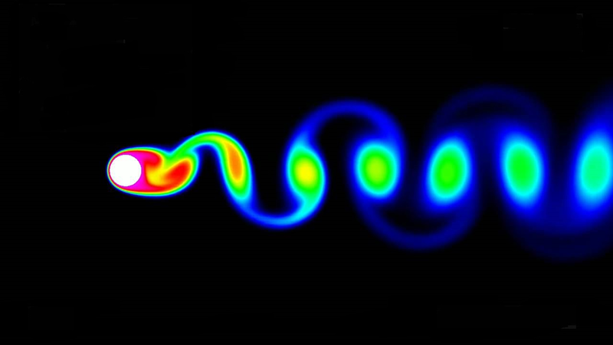
THEORY
Karman vortex
In Fluid Dynamics, a Karman vortex street is a repeating pattern of swirling vortices, caused by a process known as Vortex Shedding, which is responsible for the unsteady separation of Fluid around blunt bodies. It is named after the engineer and fluid dynamicist Theodore Von Karman.
Vortex shedding is a phenomenon when the wind blows across a structural member, vortices are shed alternately from one side to the other, and where alternating low-pressure zones are generated on the downwind side of the structure giving rise to a fluctuating force acting at right angles to the wind direction.
Vortices are a major component of turbulent flow. The distribution of velocity, vorticity (the curl of the flow velocity), as well as the concept of circulation is used to characterize vortices. In most vortices, the fluid flow velocity is greatest next to its axis and decreases in inverse proportion to the distance from the axis.

Slide 4
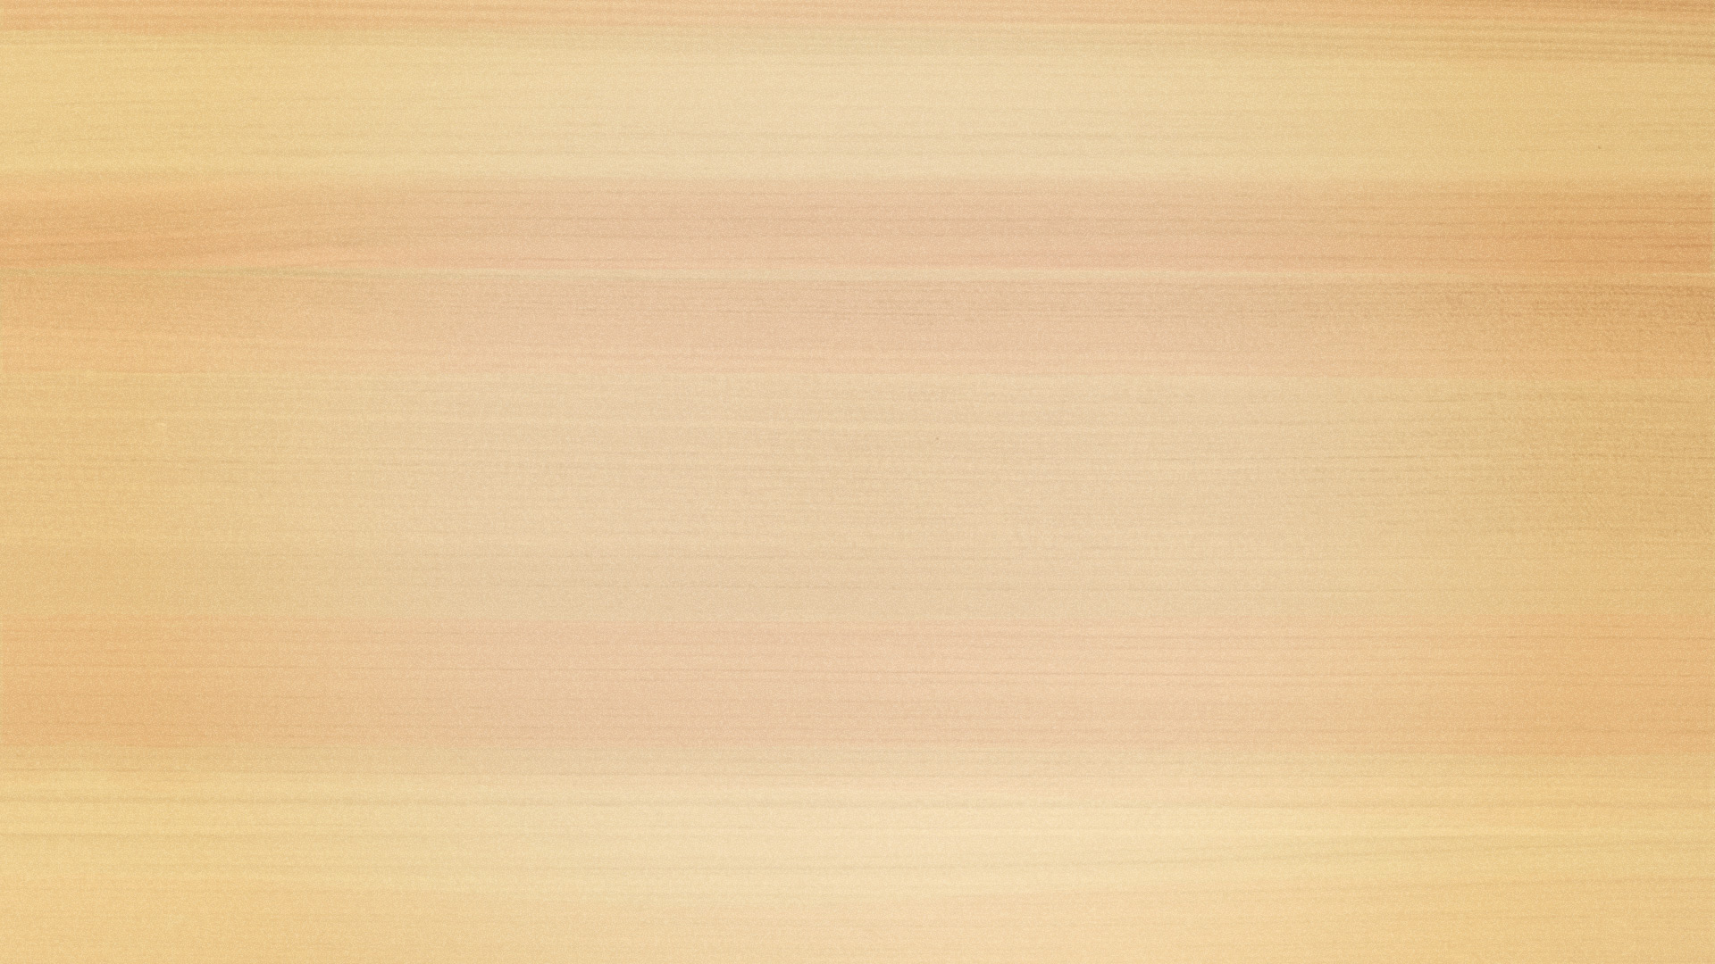
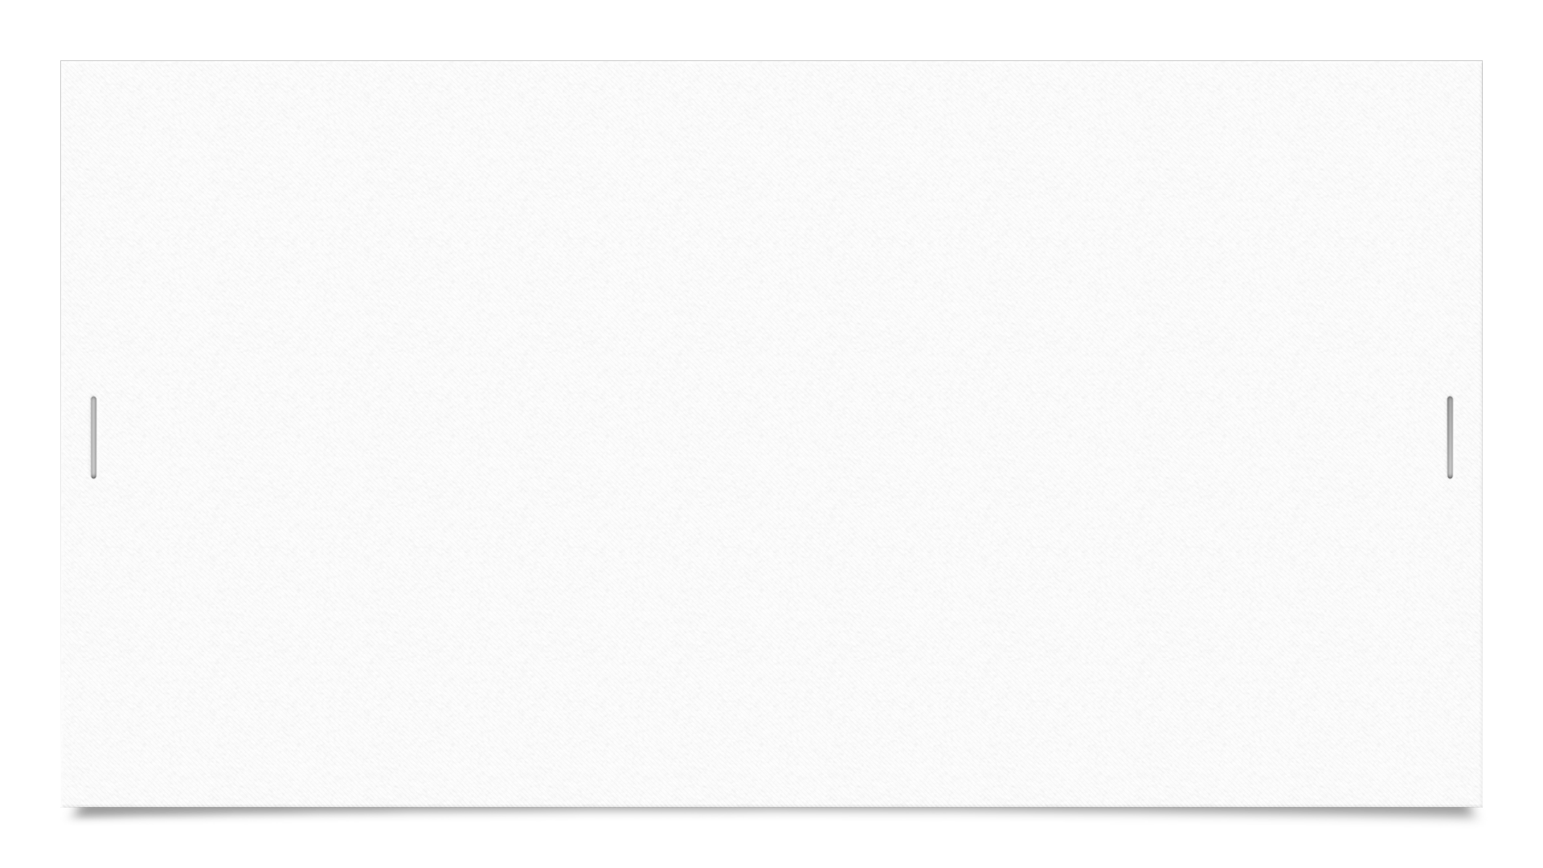
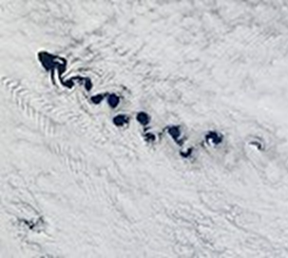
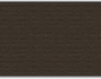
For common flows (the ones which can usually be considered as incompressible or isothermal), the kinematic viscosity is everywhere uniform over all the flow field and constant in time, so there is no choice on the viscosity parameter, which becomes naturally the kinematic viscosity of the fluid being considered. On the other hand, the reference length is always an arbitrary parameter, so particular attention should be put when comparing flows around different obstacles or in channels of different shapes: the global Reynolds numbers should be referred to the same reference length. This is actually the reason for which most precise sources for air foil and channel flow data specify the reference length at a prefix to the Reynolds number. The reference length can vary depending on the analysis to be performed: for a body with circle sections such as circular cylinders or spheres, one usually chooses the diameter; for an air foil, a generic non-circular cylinder or a bluff body or a revolution body like a fuselage or a submarine, it is usually the profile chord or the profile thickness, or some other given widths that are in fact stable design inputs; for flow channels usually, the hydraulic diameter about which the fluid is flowing.
When a single vortex is shed, an asymmetrical flow pattern forms around the body and changes the pressure distribution. This means that the alternate shedding of vortices can create periodical lateral (sideways) forces on the body in question, causing it to vibrate. If the vortex shedding frequency is similar to the natural frequency of a body or structure, it causes resonance.

Slide 5
Physics behind Vortex formation:
As a Fluid particle flows towards the leading edge of a cylinder, the pressure on the particle rises from the free stream pressure to stagnation pressure. The high fluid pressure near the leading edge impels flow about the cylinder as a boundary layer develops about both sides. The high pressure is not sufficient to force the flow about the back of the cylinder at high Reynolds number. Near the widest section of the cylinder, the boundary layer separates from each side of the cylinder surface and form 2 shear layers. Since the innermost portion of the shear layers, which is in contact with the cylinder, moves much more slowly than the outermost portions of the shear layers which is in contact with the free flow, the shear layers roll near the wake.
Understanding the physics behind vortex shedding is quite important from an engineering point of view. For example, if the bluff structure is not mounted rigidly and the frequency of vortex shedding matches the resonance frequency of the structure, then the structure can begin to resonate and starts vibrating. These vibrations can cause severe damage to the structure.

Slide 6
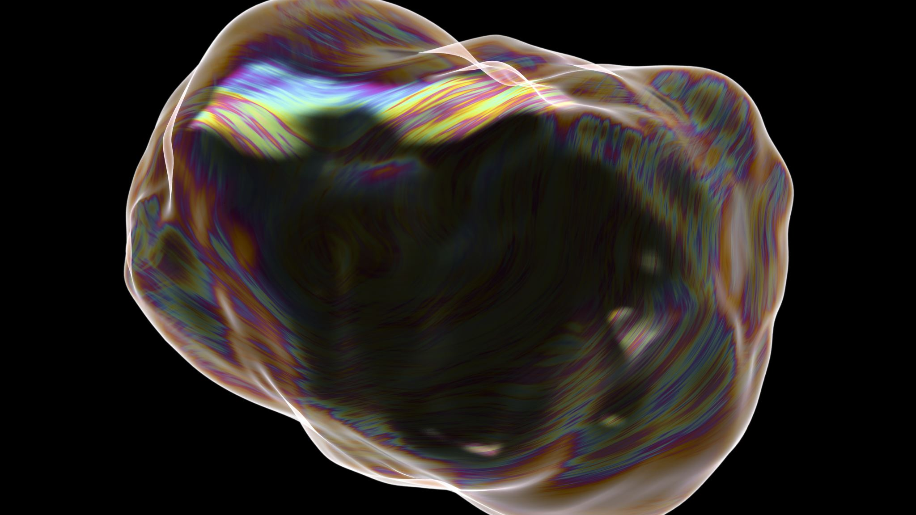
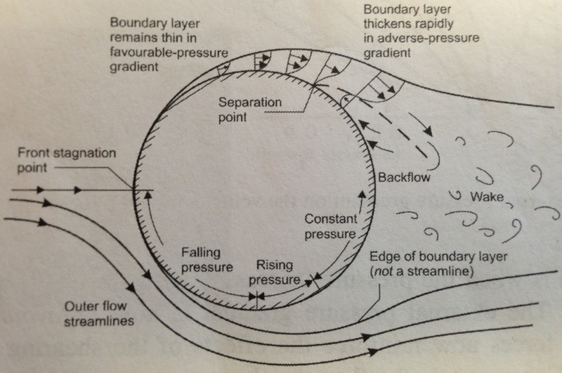
The boundary layer separates from the surface forms a free shear layer and is highly unstable. This shear layer will eventually roll into a discrete vortex and detach from the surface (a phenomenon called vortex shedding). Another type of flow instability emerges as the shear layer vortices shed from both the top and bottom surfaces interact with one another. They shed alternatively from the cylinder and generates a regular vortex pattern (the Karaman vortex street) in the wake. The vortex shedding occurs at a discrete frequency and is a function of the Reynolds number. The dimensionless frequency of the vortex shedding, the shedding Strouhal number, St = f D/V, is approximately equal to 0.21 when the Reynolds number is greater than 1,000.

Slide 7
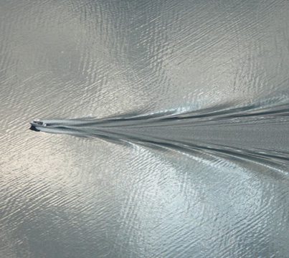
Wake
Wake is the region of recirculating flow immediately behind a moving or stationary blunt body, caused by viscosity, which may be accompanied by flow separation and turbulence. It is basically the region of disturbed flow downstream of a solid body moving through a fluid.
Wake pattern created by small boat

Slide 8
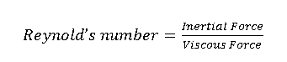
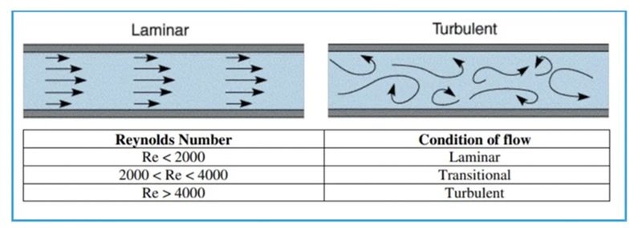
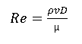
Reynold’s Number
Reynold’s number is a dimensionless quantity that is used to determine the type of flow pattern as laminar or turbulent while flowing through a pipe. Reynolds number is defined by the ratio of inertial forces to that of viscous forces.
The formula is given by,
Where,
ρ = Density of fluid Kg/m³
D = Diameter of Cylinder m
v = Velocity of Fluid m/s
µ= Kinematic Viscosity of Fluid m²/s

Slide 9
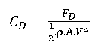
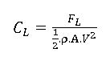
Drag Co-efficient
Drag coefficient is a dimensionless quantity that is used to quantify the drag or resistance of an object in a fluid environment, such as air or water. A lower drag coefficient indicates the object will have less aerodynamic or hydrodynamic drag. The drag coefficient is always associated with a particular surface area.
Where,
F_{D}= Drag Force
ρ = Fluid Density
A = Projected Area of Object with respect to which drag force is calculated
v = Flow Velocity.
Lift Co-efficient
The lift coefficient (CL) is a dimensionless coefficient that relates the lift generated by a lifting body to the fluid density around the body, the fluid velocity and an associated reference area. CLCL is a function of the angle of the body to the flow, its Reynolds number and its Mach number.
Where,
FL = Lift Force
ρ = Fluid Density
A = Projected Area of Object with respect to which lift force is calculated
v = Flow Velocity

Slide 10
PREPROCESSING AND MODELLING APPROACH
The computational domain for the flow over a cylinder is constructed in space claim
Symmetry wall
U
Outlet
Inlet
10D
D
Cylinder
Symmetry wall
10D
20D

Slide 11
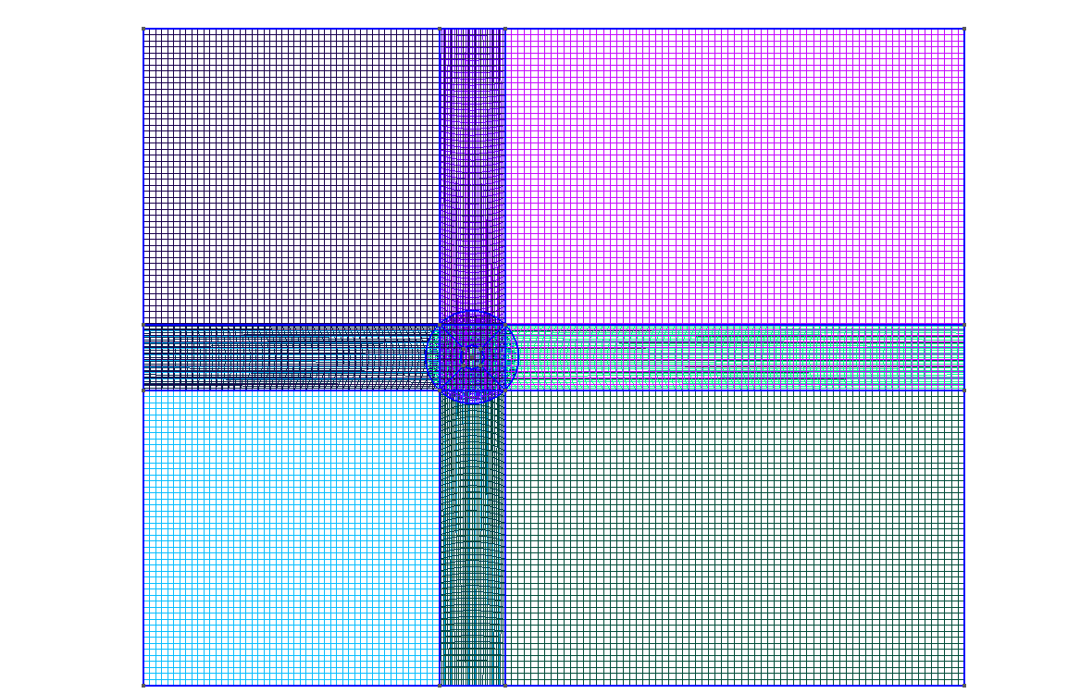
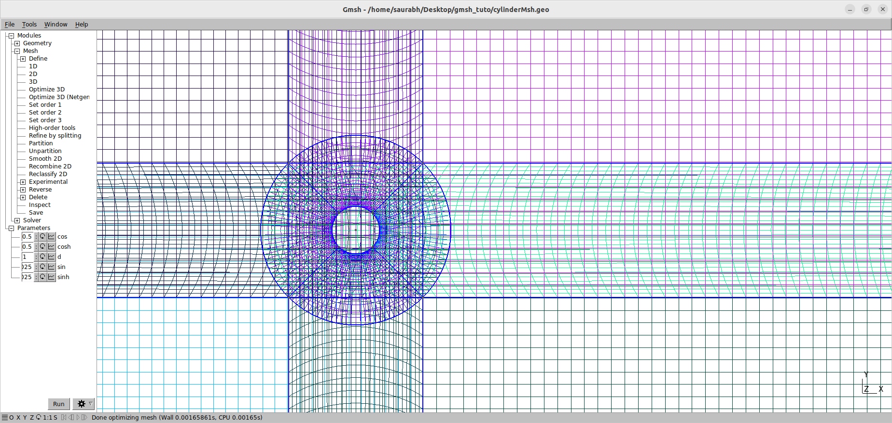
Mesh:
Mesh created using Gmsh software
Link for Gmsh file : Gmsh geo file

Slide 12
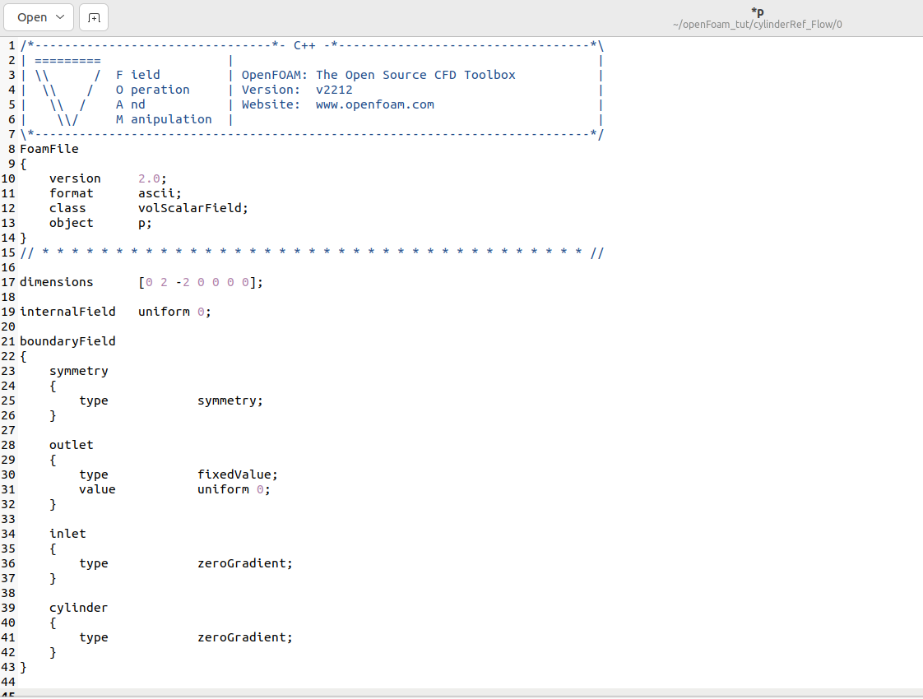
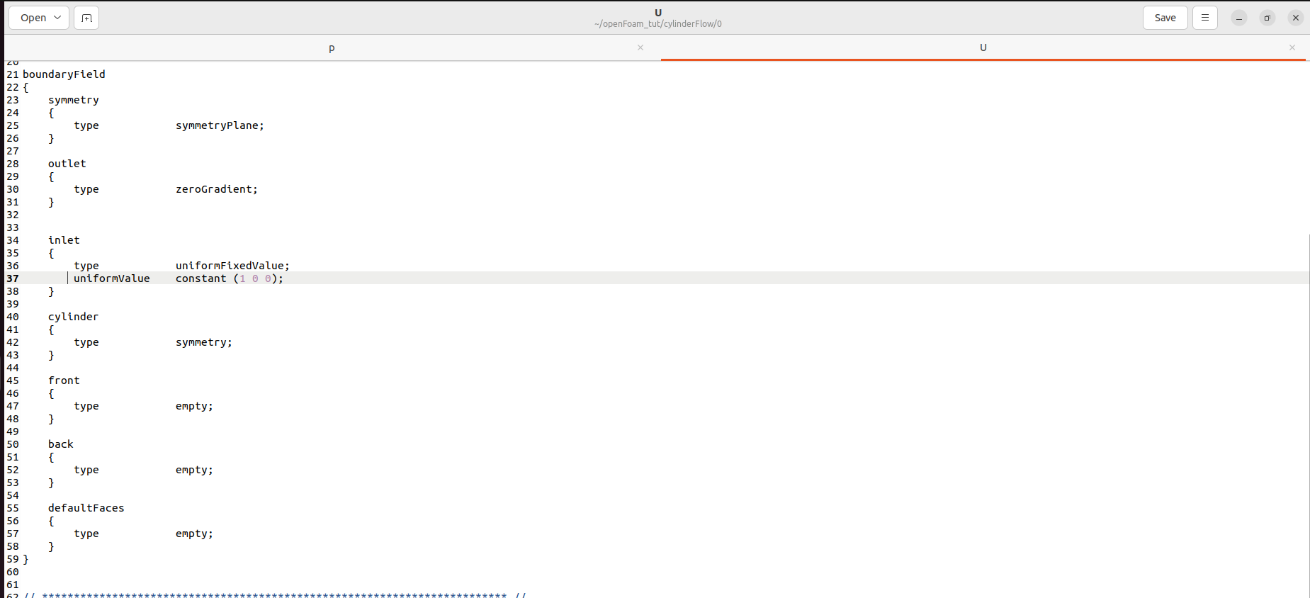
Boundary conditions for P and U file from openFOAM

Slide 13
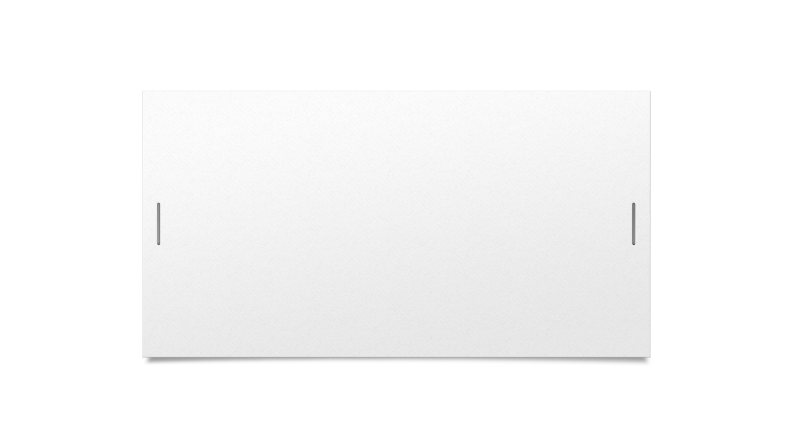
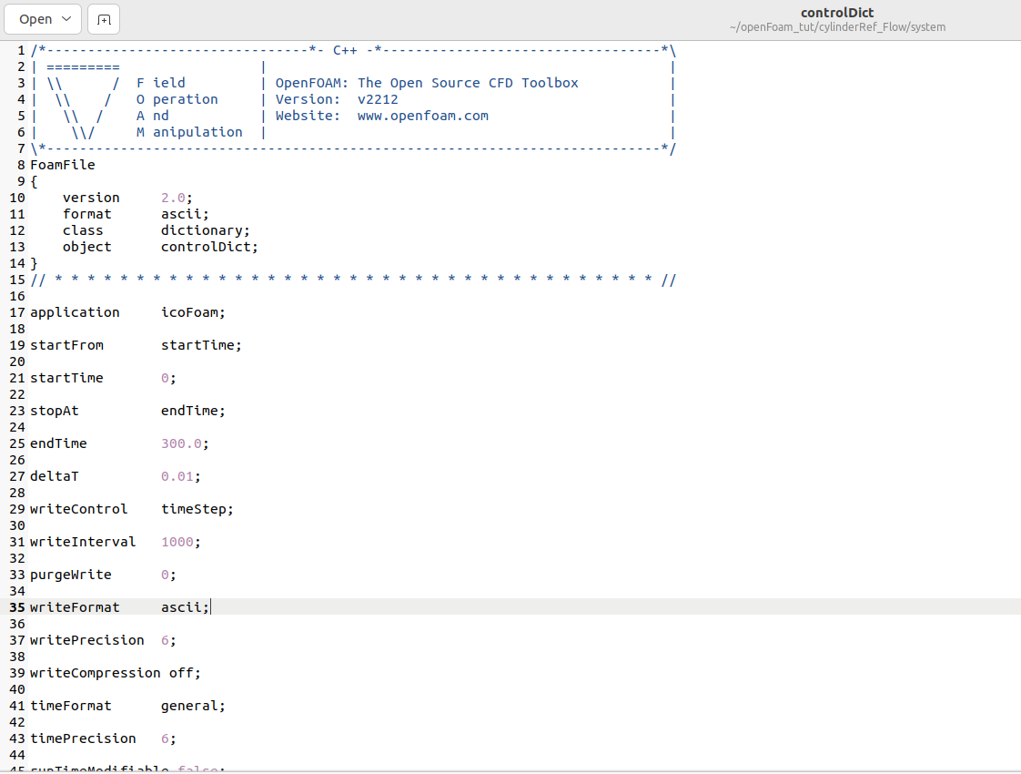
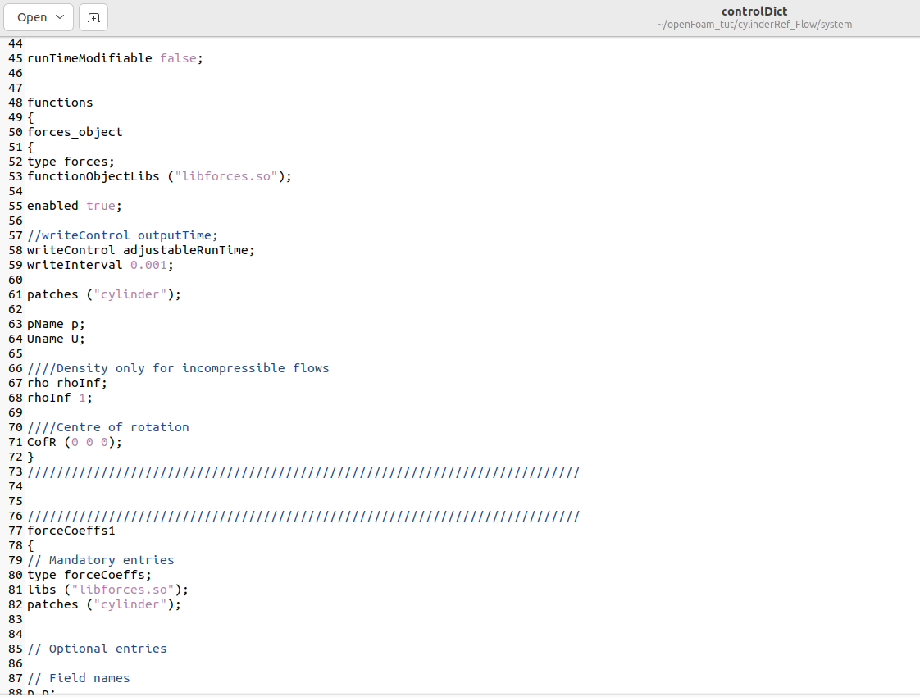
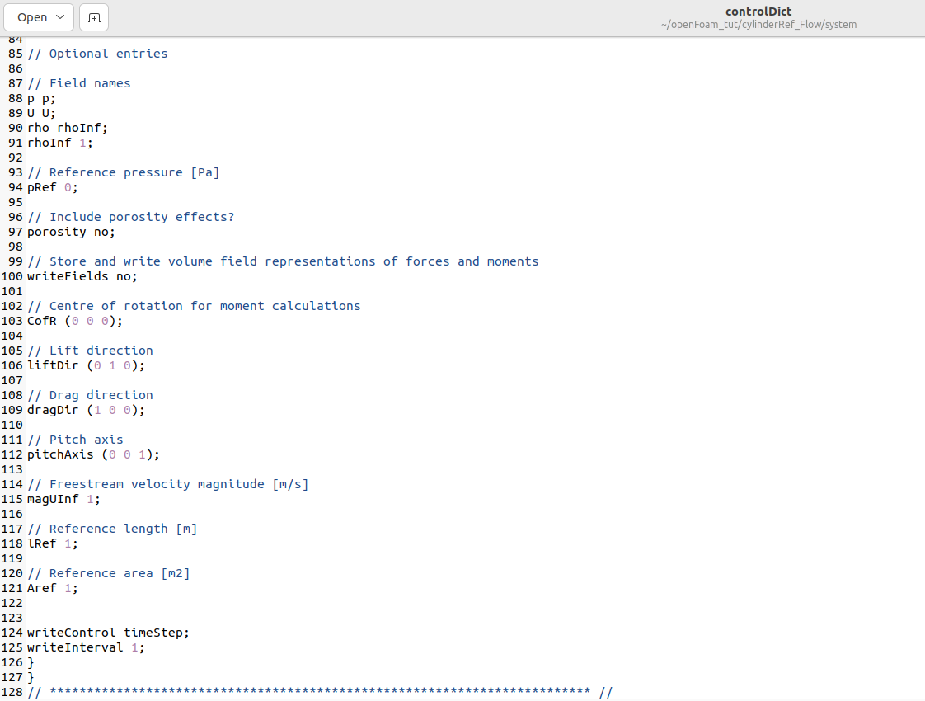
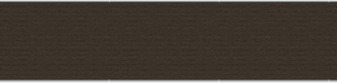
Control Dict. File : openFOAM

Slide 14
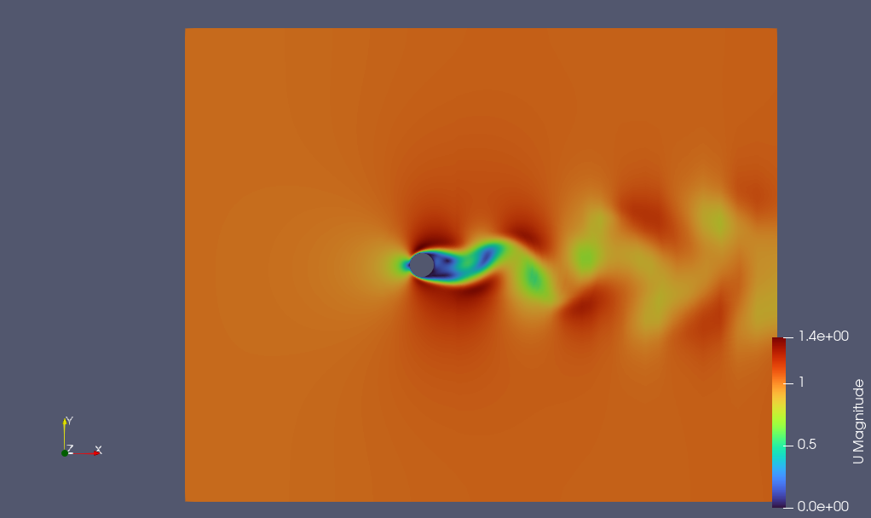
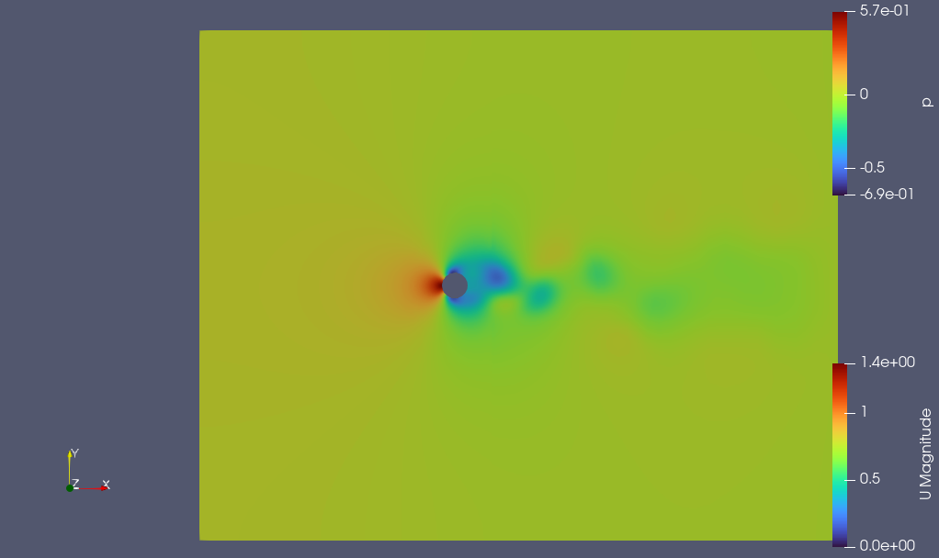
Fig. : Pressure contours as obtained in Paraview
RESULTS AND POST PROCESSING:
Reynolds number : 100
Flow : steady
Fig. : Velocity contours as obtained in Paraview

Slide 15
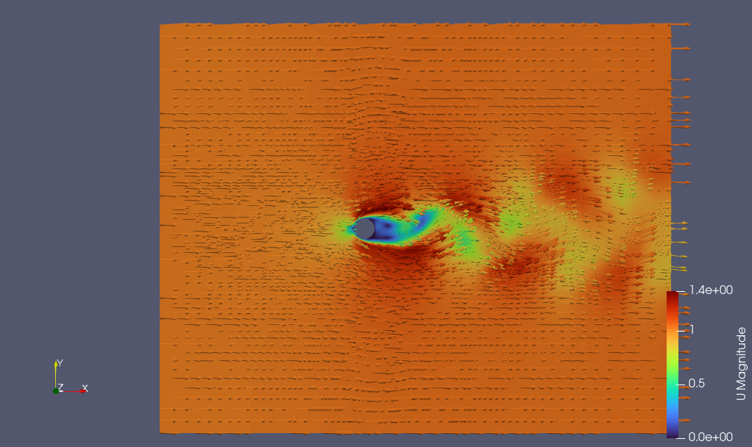
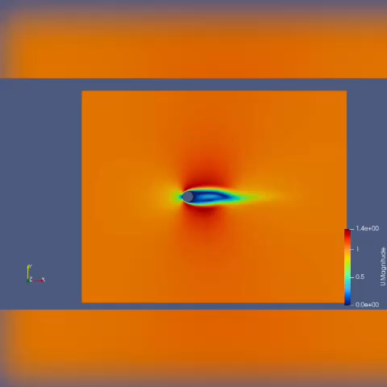
Velocity Vector
Animation

Slide 16

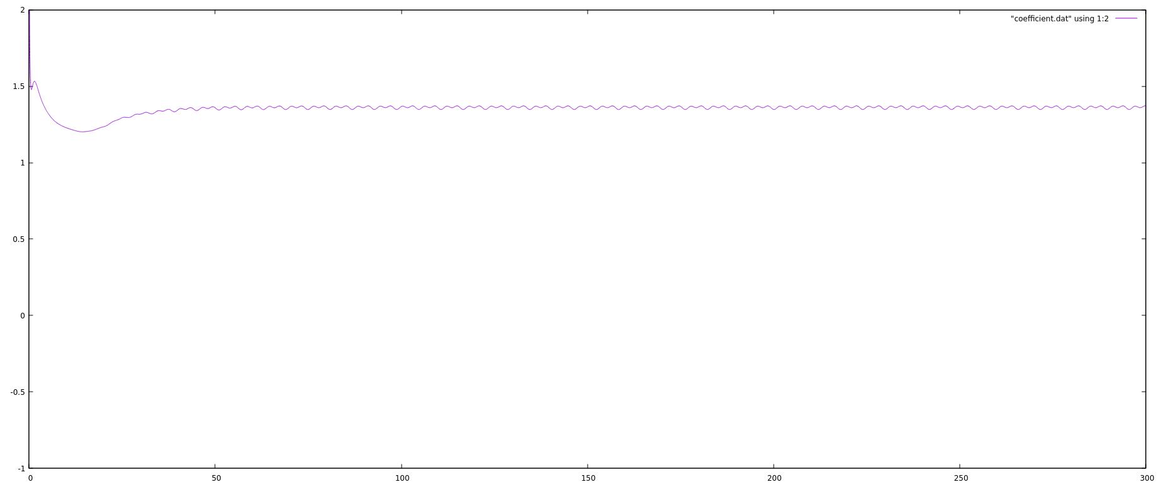
RESULTS:
Fig. : Plot of drag with time

Slide 17
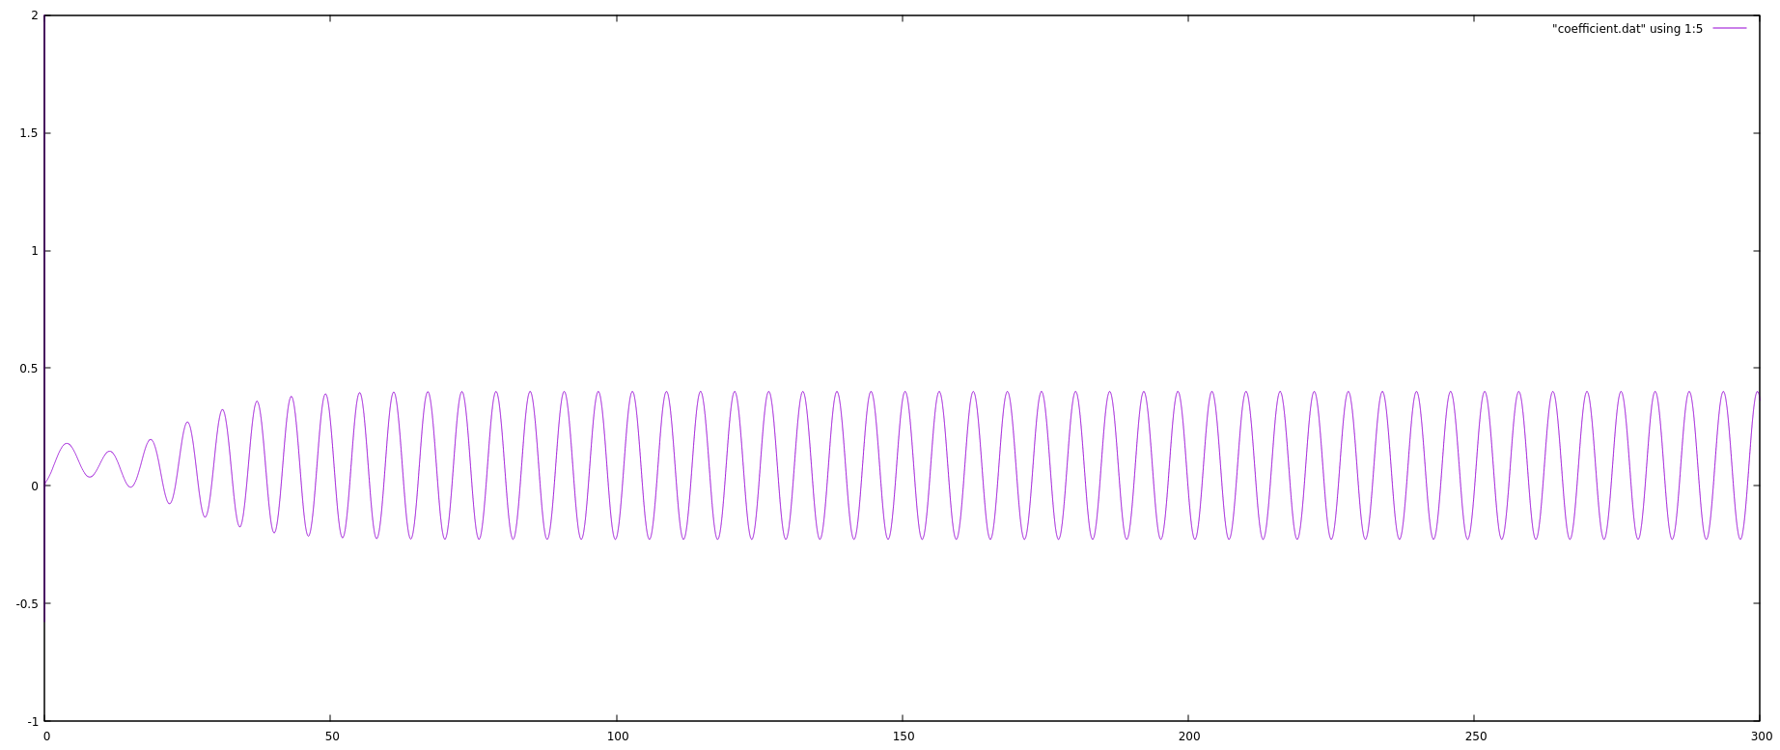
Fig. : Plot of Lift with time

Slide 18
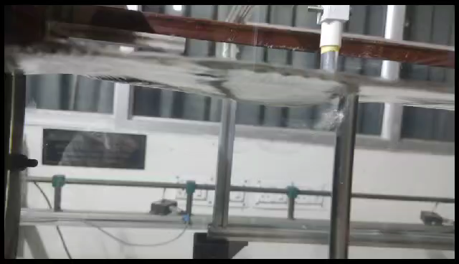
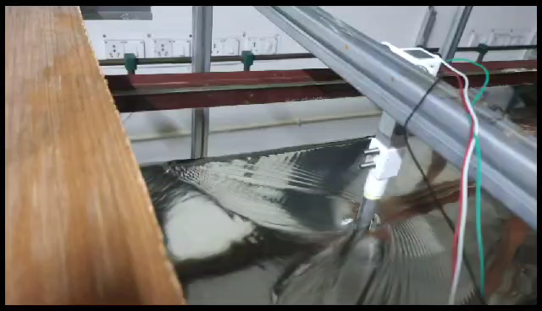
Experimental set-up :
Courtsey : Sanu Sourav ( B. Tech, Mech. Engg, IIT Guwahati)

Slide 19
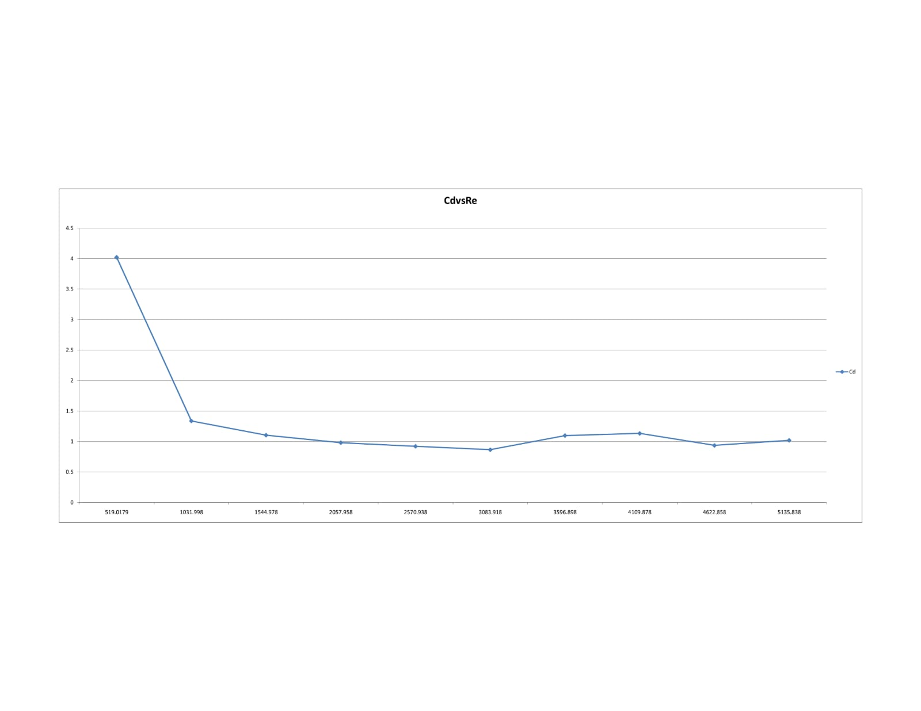
Plot of Cd v/s Re :
Courtsey : Sanu Sourav ( B. Tech, Mech. Engg, IIT Guwahati)

Slide 20
Conclusion:
The fluid flow over a cylinder has successfully been simulated for the Reynold’s Number 100 and the respective plots and contours have been obtained.
Coefficient of drag(Cd) comes out to be close to 1.3 - 1.4.
Coefficient of lift varies sinusoidal type with average zero.
Average Lift is Zero.
Vortex shedding is not much significant as we operated on low Reynolds number.
Transient state simulation takes a very high simulation time to compute the results and the number of iterations or timesteps it takes to reach a steady state is also very high.
Link :
Various coefficients obtained

Slide 21
MESHING OF WIND TURBINE:
A schematic of the computational domain and the boundary conditions
Symmetry
Interface
14R
Velocity inlet
2.5R
Pressure outlet
Symmetry
7R
14R

Slide 22
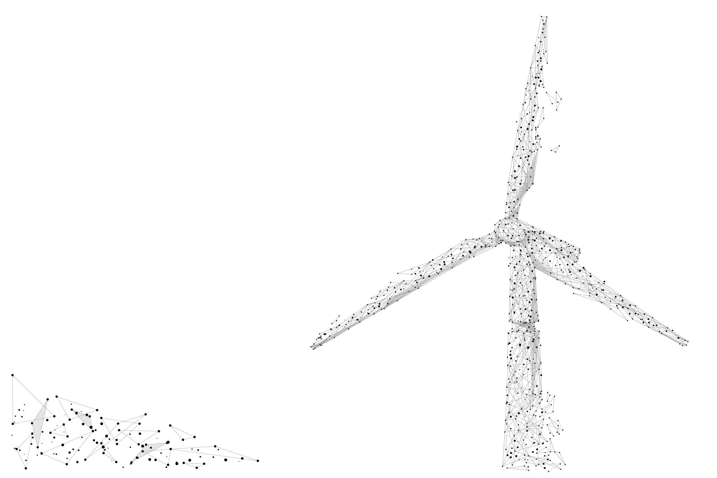
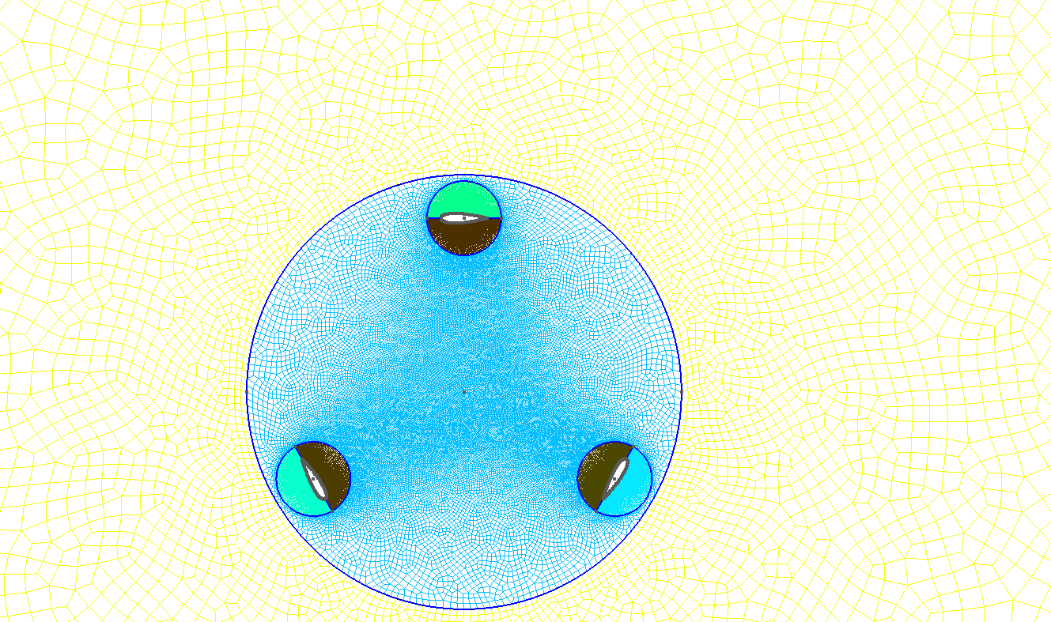
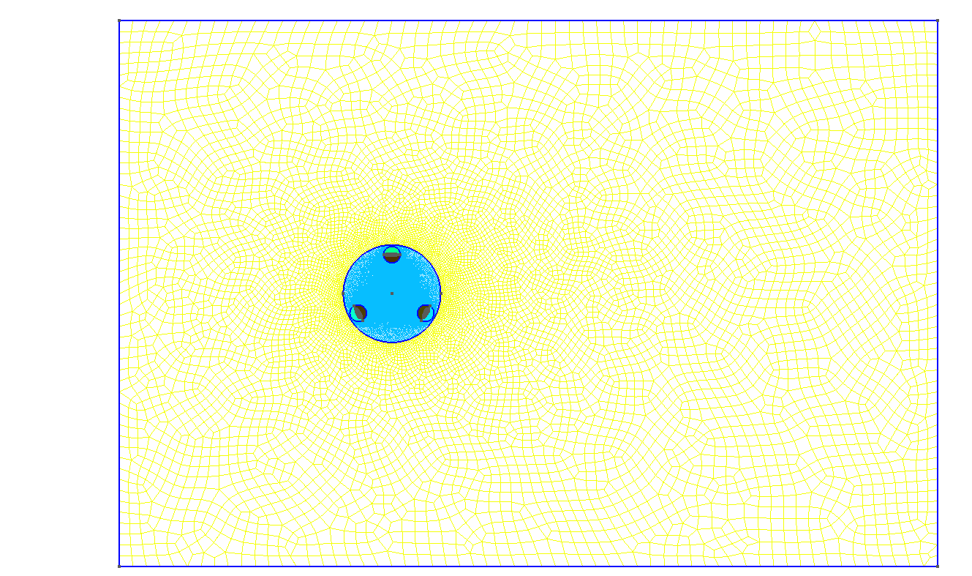
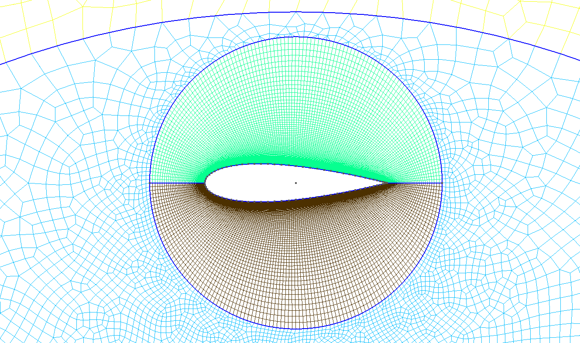
Meshing of Wind Turbine:
Airfoil : NACA0021
Link : geo file for windTurbine
Link : geo file for airfoil(NACA0021)

Slide 23

Automation of VFD frequency
VFD : A Variable Frequency Drive (VFD) is a type of motor controller that drives an electric motor by varying the frequency and voltage supplied to the electric motor. Other names for a VFD are variable speed drive, adjustable speed drive, adjustable frequency drive, AC drive, microdrive, and inverter.
A VFD can be controlled manually or through softwares. Modbus Poll is one of the softwares that is used to control such devices.
Modbus Poll is a Modbus master simulator designed primarily to help developers of Modbus slave devices or others that want to test and simulate the Modbus protocol.
Link :
Code for automation of VFD

Slide 24
Displacement Sensor(ILD 1420)
In order to record the data we need to operate the motor at different frequency from time to time, that is being done by VFD.
To record the minute displacements of the object placed in the flow we need high frequency Laser Sensors.
These sensors are being operated by its software ILD 1420 Tool where we can record the data by a single press.
Since recording data is a manual task from software, it is convenient to automate it.
Link :
Code for ILD1420

Slide 25

!! THANK YOU !!

